Slide 1
Git – Best Practises
Moritz Flüchter

Slide 2
Content
HEADING
How to work in groups
What belongs in a git repository?
When to commit?

Slide 3
How to work in groups
Problems when working in groups
Working on the same files/code lines may lead to merge conflicts!
Git is smart and sometimes merge changes automatically, but it cannot do everything!

Slide 4
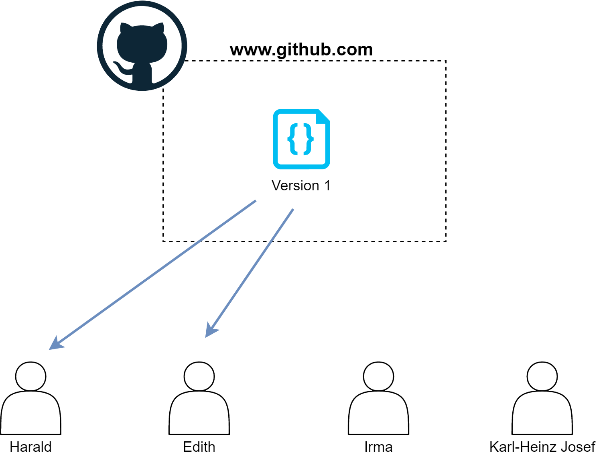
How to work in groups
Problems when working in groups

Slide 5
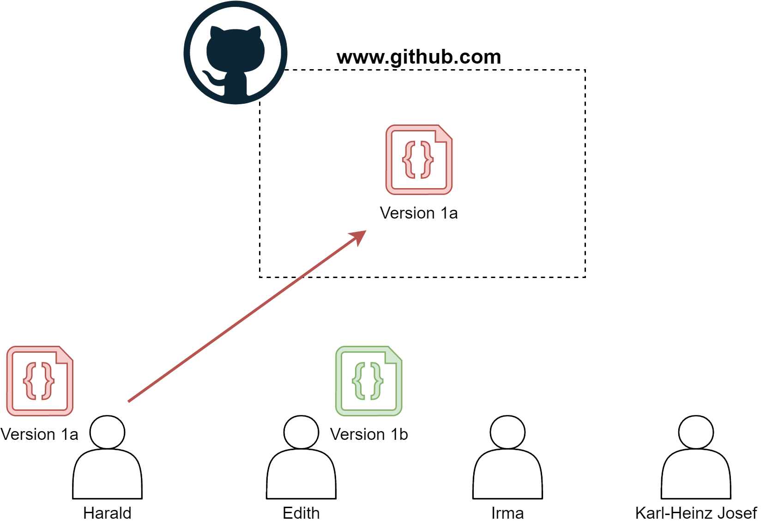
How to work in groups
Problems when working in groups

Slide 6
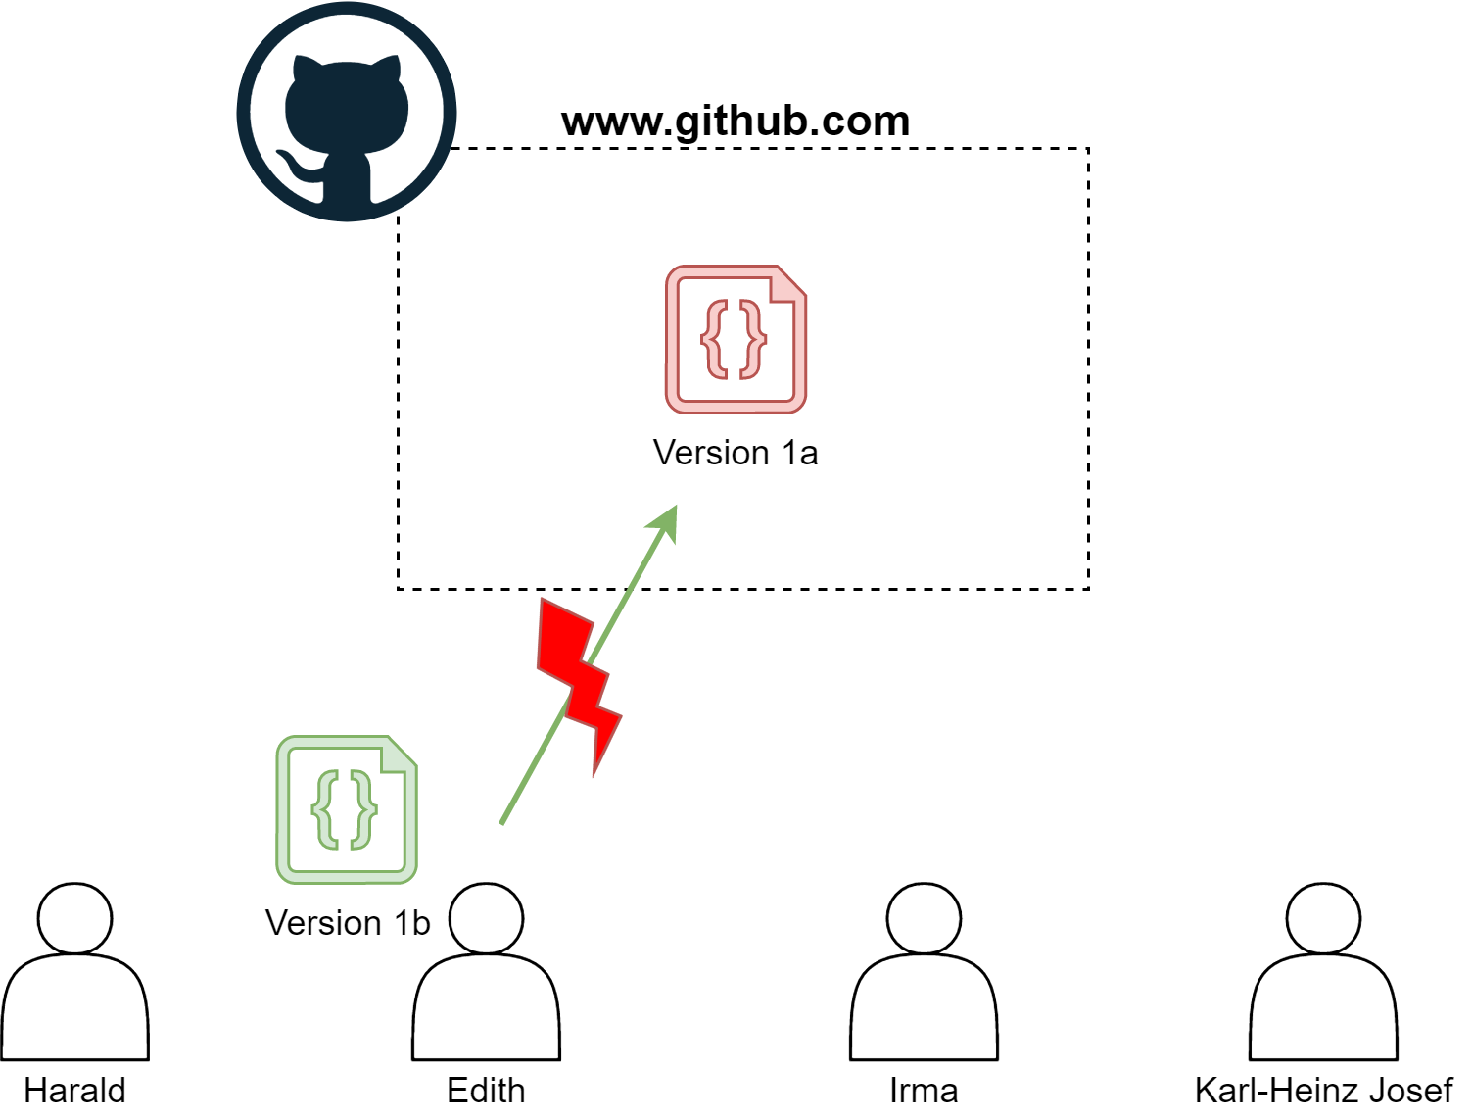
How to work in groups
Problems when working in groups

Slide 7
How to work in groups
Problems when working in groups
Edith has to fix it ☹

Slide 8
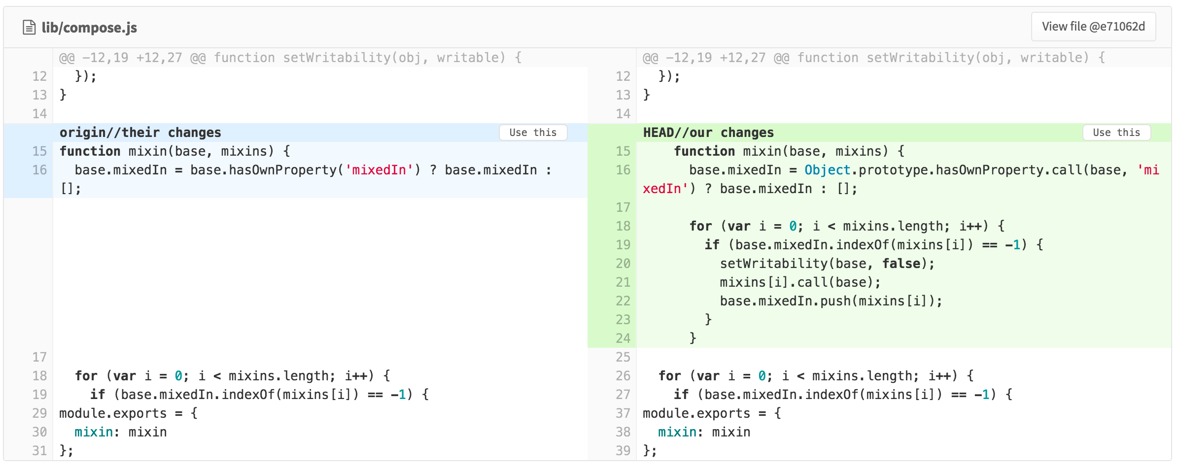
How to work in groups
Problems when working in groups
https://about.gitlab.com/images/blogimages/resolving-merge-conflicts-from-the-gitlab-ui/merge-conflicts.png
You have to use a texteditor for fixing merge conflicts! Git will use your standard editor for this
Notes:
The person having merge conflicts needs to decide which changes should be kept and which should be dropped
Make these chanegs and commit them

Slide 9

How to work in groups
BRANCHES
A commit
https://www.nobledesktop.com/image/gitresources/git-branches-merge.png
Notes:
Branches represent parrallel states of the repository

Slide 10
What belongs in a repository?
DONTS
DOS
Very large files e.g. long videos
Automatically generated files
PASSWORDS!!!!!!!
Sourcecode files
Config files
Documentation files
Notes:
After that all changes are tracked inside of the other branch

Slide 11
When to commit?
Changes inside a commit should be related
Keep them as small as possible
Commit often
Use meaningful commit messages (NOT: „aaaa“)
E.g. when you add/change a function, class, config file, …
Notes:
After that all changes are tracked inside of the other branch

Slide 12
OLD
Notes:
Say, this creates a new sub folder, everything in thuis subfolder will now be tracked

Slide 13
How to work in groups
BRANCHES
You should create branches when developement tasks cannot be pursued at the same time!
E.g. Youre implementing a feature that temporarily breaks the program.
The master branch should always be stable!
Notes:
Master should always be stable!!!

Slide 14
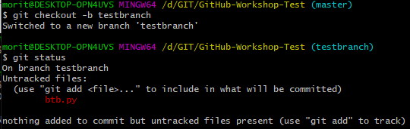
How to work in groups
BRANCHES
Creating a branch via:
$ git checkout –b [branchname]
Or via:
$ git branch [branchname]
$ git checkout [branchname]
Notes:
After that all changes are tracked inside of the other branch

Slide 15
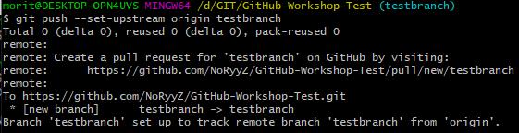
How to work in groups
BRANCHES
If the branch has not been created in the repositroy:
$ git push –set-upstream origin [branchname]
Notes:
After that all changes are tracked inside of the other branch

Slide 16
How to work in groups
MERGING BRANCHES
First, swap to master branch via:
$ git checkout master
Make sure the master is up to date:
$ git pull
Merge the branch back into the master branch:
$ git merge [branchname]
Deleting the branches:
$ git branch -d [branchname]
$ git push origin --delete [branchname]
Notes:
After that all changes are tracked inside of the other branch

Slide 17
How to work in groups
Preventing merge conflicts
Changing the same file is not as problematic as changing the same function!
Try to have little overlap between group members
Talk to each other on who does what, otherwise you may run into merge conflicts
Notes:
After that all changes are tracked inside of the other branch

